Slide 1



Hadoop Tutorial
HDFS Architecture

Slide 2
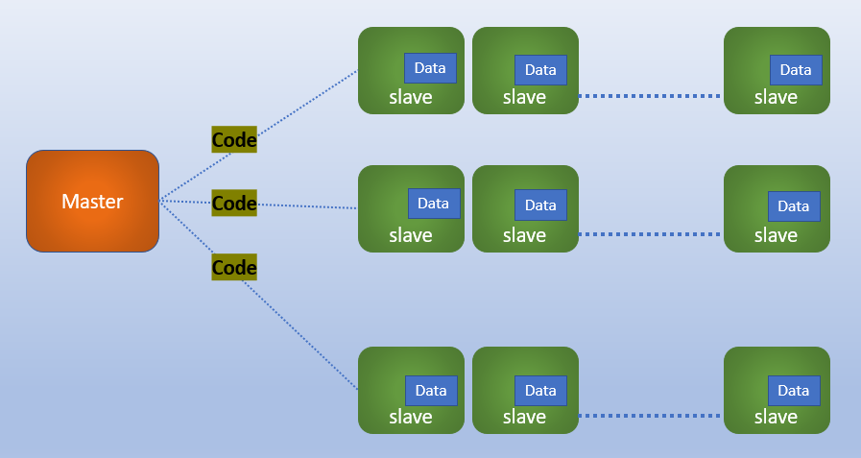
HDFS Architecture
As we discussed in the introductory video about what is Hadoop :
Apache Hadoop is the collection of software utilities that facilitate Big Data processing and storage using a network of many computers in the form of cluster consisting of several nodes.
Data Processing : MapReduce
Distributed Storage : HDFS
NAMENODE
DATA NODE

Slide 3
Hadoop / HDFS Architecture
HDFS exposes a file system which allows user data to be stored in files. Internally, a file is split into one or more blocks and these blocks are stored in a set of slave nodes.
Hadoop Distributed File System is a block-structured file system where each file is divided into blocks of a configured size, default size is 128 MB. These blocks are stored across the Slave nodes in the cluster and managed by the Master node.
HDFS has a master/slave architecture where –
NameNode, is a master server/node that stores the Metadata of the data blocks, which are stored on various slave nodes in the cluster.
DataNodes: is the slave node, which stores actual data in the HDFS.
Note: The NameNode and DataNode are pieces of software designed to run on commodity machines across the network.

Slide 4
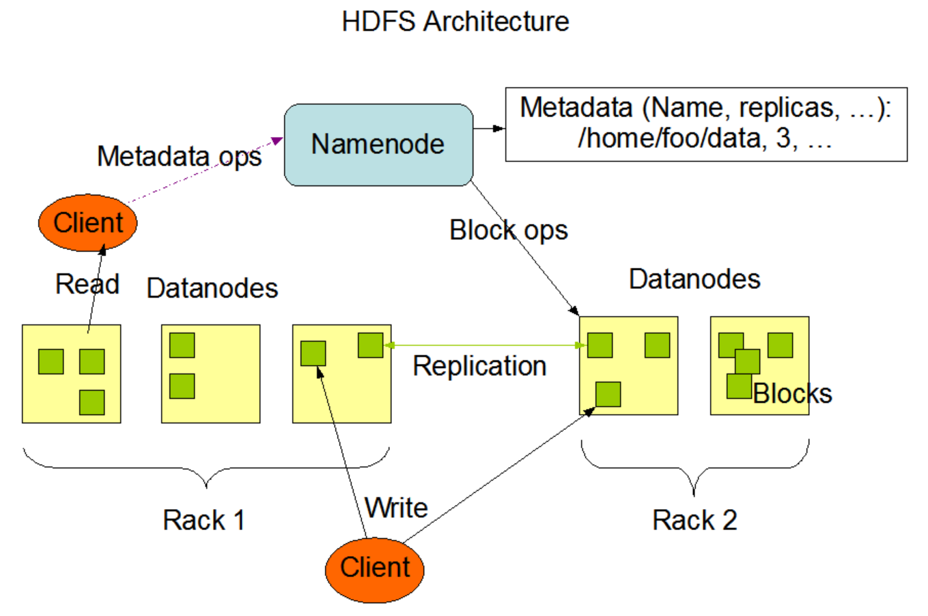

Hadoop Architecture
Image Credit :Apache.org

Slide 5

NameNode
NameNode is the master daemon that maintains and manages the DataNodes (slave nodes)
NameNode records the metadata of all the files stored in the cluster, e.g. The location of blocks stored, the size of the files, permissions, hierarchy, etc.
There are two files associated with the metadata:
FsImage: It contains the complete state of the file system namespace since the start of the NameNode.
EditLogs: It contains all the recent modifications made to the file system with respect to the most recent FsImage.
NameNode records each change that takes place to the file system metadata.
For example, if a file is deleted in HDFS, the NameNode will immediately record this.

Slide 6
NameNode
NameNode regularly receives a Heartbeat and a block report from all the DataNodes in the cluster to ensure that the DataNodes are live.
NameNode keeps a record of all the blocks in HDFS and in which nodes these blocks are located.
NameNode is also responsible to take care of the replication of the data blocks in the cluster.
In case of the DataNode failure, the NameNode chooses new DataNodes for those blocks of data presented in the failed datanode.

Slide 7
Data Node
DataNodes: are slave daemons or process which runs on each slave machine.
The actual data is stored on DataNodes.
DataNodes: perform the low-level read and write requests from the file system’s clients.
DataNodes: send heartbeats to the NameNode periodically to report the overall health of HDFS.

Slide 8
Secondary NameNode
Secondary NameNode is the third process apart from NameNode and the Datanode.
The Secondary NameNode works concurrently with the primary NameNode as a helper daemon.
Secondary NameNode is not the backup of the Namenode.
The Secondary NameNode is one which constantly reads all the file systems and metadata from the RAM of the NameNode and writes it into the hard disk or the file system.
Secondary name node helps Namenode to do the bulky task of managing the state of the system.

Slide 9
Secondary Node
Secondary Node
Query for edit logs in regular interval
NameNode
Update FsImage with editlogs
FsImage
Copy the update FsImage back to NameNode
FsImage

Slide 10
Thanks and do subscribe to my channel

